Slide 1
E-COMMERCE CAPSTONE PROJECT
Highly Available Online Vinyl Store
A WordPress + WooCommerce record shop, deployed with Terraform
Prepared by Houssem · October 2026

Slide 2
OVERVIEW
Agenda
01
Store goal & architecture
02
Core AWS components
What the shop needs and how it fits together
Network, storefront, and catalog database
03
High availability & security
04
Infrastructure as Code
Surviving failure, layered access
The project defined in Terraform
05
Terraform code examples
06
Live store & deployment
VPC and subnets, in detail
The running shop, and cleanup
Online Vinyl Store on AWS · WordPress + WooCommerce
2

Slide 3
STORE GOAL
The Goal: An Online Vinyl Store That Never Skips
Run an online vinyl record shop that stays open during release-day rushes and scales with demand — all defined and deployed from code.
1
2
3
4
Always Open
Scales on Demand
Secure Checkout
Automation
Keep the shop online even if an entire Availability Zone goes down.
Add servers automatically when a hot release sends traffic spiking.
Layered access — customer and order data is never exposed to the internet.
Build the whole store environment from code, repeatably, in one command.
Online Vinyl Store on AWS · WordPress + WooCommerce
3

Slide 4
THE BIG PICTURE
Store Architecture at a Glance
Users / Internet
Internet Gateway
VPC · 10.0.0.0/16
Public Subnets · us-west-2a / us-west-2b
Application Load Balancer — HTTP :80
NAT Gateway
Private Subnets · us-west-2a / us-west-2b
Auto Scaling Group (Storefront Fleet)
EC2 · Store #1
EC2 · Store #2
MySQL · catalog & orders · :3306
Online Vinyl Store on AWS · WordPress + WooCommerce
4

Slide 5
CORE COMPONENTS · 1 OF 3
The Network Foundation
1
VPC (10.0.0.0/16)
2
Two Availability Zones
A private, isolated network inside AWS that holds every resource in the project.
Resources are duplicated across two separate data centers for redundancy.
3
Public Subnets
4
Private Subnets
Internet-facing tier — holds the load balancer and the NAT gateway.
Protected tier — holds the WordPress servers and the database, with no direct internet access.
5
Internet Gateway
6
NAT Gateway
The doorway that lets public traffic reach the load balancer.
Lets private servers reach out for updates while staying unreachable from outside.
Online Vinyl Store on AWS · WordPress + WooCommerce
5

Slide 6
CORE COMPONENTS · 2 OF 3
The Storefront & Load Balancing
1
Application Load Balancer
Receives all shopper traffic on port 80 and spreads it evenly across the store servers. It health-checks each one and stops sending traffic to any that fail.
2
Auto Scaling Group
Keeps a fleet of servers running — 2 by default, growing to 4 when CPU passes 60%. If a server dies or an AZ fails, it automatically launches a replacement.
3
EC2 Instances (Storefront)
Amazon Linux 2023 servers running Apache + PHP with WordPress and the WooCommerce shop. Each boots and configures itself, then connects to the shared catalog database.
Online Vinyl Store on AWS · WordPress + WooCommerce
6

Slide 7
CORE COMPONENTS · 3 OF 3
The Database Layer
One MySQL database holds the vinyl catalog, customer accounts, and every order — in a private subnet reachable only by the store servers.
MySQL on EC2
Private & isolated
Runs MariaDB (MySQL) on a private EC2 instance that the storefront fleet connects to over the VPC.
Sits in a private subnet; only the storefront security group can reach it on port 3306.
Designed for RDS
Production upgrade
The intended design uses Amazon RDS Multi-AZ — swapped to EC2 because the lab environment restricts RDS.
Moving to RDS would add managed failover, automated backups, and patching with no code rewrite.
Online Vinyl Store on AWS · WordPress + WooCommerce
7

Slide 8
DEFENSE IN DEPTH
Security: A Layered Chain
Each tier only accepts traffic from the tier in front of it — so customer and order data in the database is never reachable from the internet.
Internet
ALB
EC2 Fleet
Database
0.0.0.0/0
allows :80
allows :80 from ALB
allows :3306 from EC2
Servers live in private subnets — no public IPs
Database password is auto-generated, never hard-coded
IMDSv2 enforced & storage encrypted
Online Vinyl Store on AWS · WordPress + WooCommerce
8

Slide 9
HIGH AVAILABILITY & SCALING
Built to Survive Failure & Handle Load
2
2 → 4
Self
Availability Zones
Auto-scaling servers
Self-healing fleet
The storefront is duplicated across two data centers.
The fleet grows and shrinks with demand, automatically.
Unhealthy servers are detected and replaced with no action.
What happens when a release drops and traffic spikes?
The load balancer stops routing to the failed zone and the Auto Scaling Group launches replacements in the healthy zone, so the shop keeps selling. (Database HA is the RDS upgrade noted earlier.)
Online Vinyl Store on AWS · WordPress + WooCommerce
9

Slide 10
AUTOMATION
Infrastructure as Code with Terraform
✓
Everything in code
Terminal
The entire environment is defined in ~10 text files.
$ terraform init
Terraform has been initialized.
$ terraform plan
Plan: 26 to add.
$ terraform apply
Apply complete! 26 added.
wordpress_url = http://ha-wordpress...
✓
One command to build
terraform apply creates all 26 resources in order.
✓
One command to remove
terraform destroy tears it all down — no leftovers.
✓
Repeatable & reviewable
Version-controlled, consistent, and easy to share.
Online Vinyl Store on AWS · WordPress + WooCommerce
10

Slide 11
TERRAFORM CODE · EXAMPLE 1
Defining the Network: VPC & Gateway
A few lines of Terraform describe the private network and its door to the internet.
# The VPC — a private, isolated 10.0.0.0/16 network
resource "aws_vpc" "main" {
cidr_block = var.vpc_cidr
enable_dns_support = true
enable_dns_hostnames = true
tags = { Name = "ha-wordpress-vpc" }
}
# The Internet Gateway: the VPC's door to the internet
resource "aws_internet_gateway" "main" {
vpc_id = aws_vpc.main.id
tags = { Name = "ha-wordpress-igw" }
}
Online Vinyl Store on AWS · WordPress + WooCommerce
11

Slide 12
TERRAFORM CODE · EXAMPLE 2
Defining the Subnets
Using count, two lines of config create a public and a private subnet in each Availability Zone.
# Two public subnets — one per Availability Zone
resource "aws_subnet" "public" {
count = 2
vpc_id = aws_vpc.main.id
cidr_block = var.public_subnet_cidrs[count.index]
availability_zone = var.availability_zones[count.index]
map_public_ip_on_launch = true
}
# Two private subnets — for the servers and the database
resource "aws_subnet" "private" {
count = 2
vpc_id = aws_vpc.main.id
cidr_block = var.private_subnet_cidrs[count.index]
availability_zone = var.availability_zones[count.index]
}
Online Vinyl Store on AWS · WordPress + WooCommerce
12

Slide 13
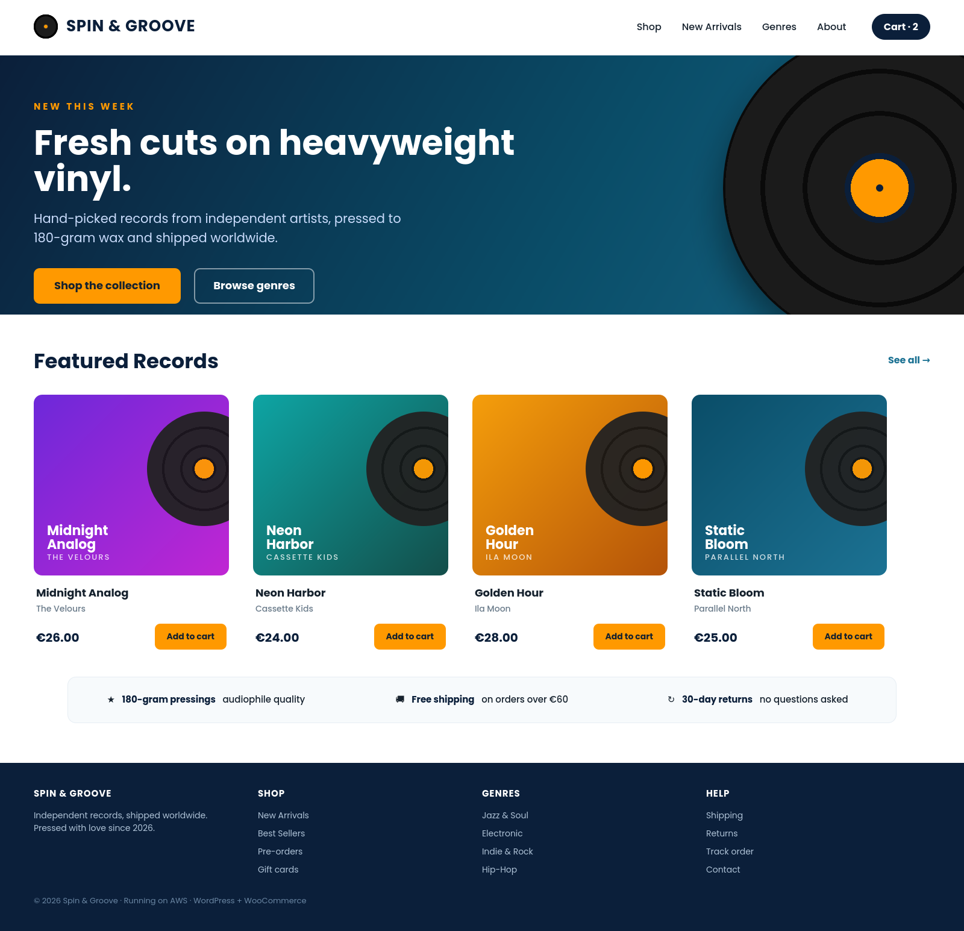
STORE DESIGN
The Storefront — Front-Page Design
spinandgroove.com
1
Bold hero + CTA
A headline and a 'Shop the collection' button drive the first click.
2
WooCommerce product grid
Featured records pulled straight from the store catalog.
3
Trust signals
Shipping, returns and quality badges reassure buyers at a glance.
4
Clear nav & footer
Shop, genres and help links guide shoppers through the whole store.
Houssem was here
Online Vinyl Store on AWS · WordPress + WooCommerce
13

Slide 14
PUTTING IT LIVE
Deployment & Cleanup
1
2
3
4
Configure AWS access
terraform init
terraform plan
terraform apply
Temporary credentials from the AWS lab.
Download the AWS provider (one time).
Preview every resource before creating.
Build the full stack and get the site URL.
Remember to clean up
!
The load balancer, NAT gateway, and database cost money while running. Run terraform destroy when finished to remove everything.
Online Vinyl Store on AWS · WordPress + WooCommerce
14

Slide 15
KEY TAKEAWAYS
A Production-Shaped E-Commerce Architecture
✓
Always open
✓
Scales on demand
The storefront is redundant across two Availability Zones.
The storefront fleet adjusts to shopper traffic on its own.
✓
Secure checkout
✓
Fully automated
Layered access with customer & order data fully private.
The whole stack is built and destroyed from code.
Thank you · Questions?

